Slide 1
Attribute-Based-Encryption in Disruption Tolerant Military Networks to secure data access
A Wireless Network based Scheme
Project Guide –
Mr. V. Hemakumar , Assistant Professor,
Department of CSE.
Project by –
Sonia. M,
Final Year , CSE-B.

Slide 2

Wireless devices carried by soldiers in hostile areas or battle fields are likely to suffer the threats of information leaks and disruptions in connectivity.
Disruption-tolerant network (DTN) technologies allow wireless devices carried by soldiers to communicate with each other and access the confidential information or command reliably by exploiting external storage nodes.
Some of the most challenging issues in this scenario are the enforcement of authorization policies and the policies update for secure data retrieval.

Slide 3
CipherText Policy- Attributes Based Encryption
Ciphertext-policy ABE (CP-ABE) provides a scalable way of encrypting data such that the encryptor defines the attribute set that the decryptor needs to possess in order to decrypt the ciphertext.
Thus, different users are allowed to decrypt different pieces of data per the security policy.
However, the problem of applying CP-ABE in decentralized DTNs introduces several security and privacy challenges with regard to the attribute revocation, key escrow, and coordination of attributes issued by authority.

Slide 4
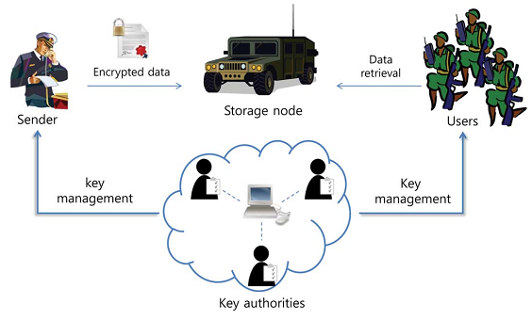
Existing System

Slide 5
Multiple authorities issue and manage their own attribute keys independently as a decentralized DTN.
The challenge is the coordination of attributes issued from different authorities.
When multiple authorities manage and issue attributes keys to users independently with their own master secrets, it is very hard to define fine-grained access policies over attributes issued from different authorities.
Furthermore, every authority can join or leave the system freely without the necessity of reinitializing the system. However, multiple authorities can collaborate to trace the user.

Slide 6
Disadvantages
Key Revocation – Updation of user Attributes in case of repositioning.
Key Escrow – Information may be leaked if the Key Authorities are compromised. Multiple authorities can collaborate to trace the user.
Coordination of Attributes – Key generation is dependent on multiple authorities . Coordinating the Central Authority and multiple key authorities is necessary to generate keys.
Forward Secrecy – A revoked user will be able to access data until expiration time even if he does not hold the required attribute.
Backward Secrecy – A user who holds the new attribute might be able to access the previously encrypted data.

Slide 7
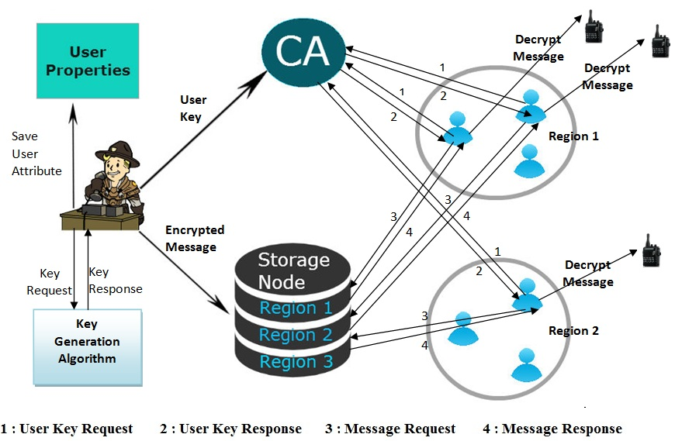
Proposed System

Slide 8
The Central Authority and Sender manage the key generation using automated scheme that generates random one-time-key based on attributes.
The Admin himself generates the Key for the User and sends it to CA. The CA then grants the Key to the User.
The CA maintains information about the time when the key was sent to the CA from Admin and the time when the message was created by the Admin.
In this technique, we are using AES Algorithm for encryption and decryption of Private Key and RSA algorithm for Encryption and Decryption of Message.

Slide 9
Advantages
Key Revocation – Updation of user Attributes in case of repositioning is done by Admin.
Key Escrow – Central authority is not explicitly involved in key generation.
Coordination of Attributes – The system is Centralized with only one Central Authority.
Forward Secrecy – A revoked user will not be able to access data the old data because the admin will remove the access for revoked user.
Backward Secrecy – A user who holds the new attribute won’t be able to access the previously encrypted data since the keys are randomly generated one-time-key. The data can be received only when admin gives access.

Slide 10
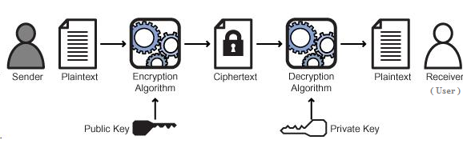
Algorithm
i) RSA Algorithm
In RSA, this asymmetry is based on the practical difficulty of factoring the product of two large prime numbers, the factoring problem.

Slide 11
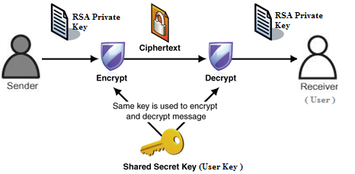
ii) AES Algorithm
AES is based on a design principle known as a substitution-permutation network, combination of both substitution and permutation.

Slide 12
 | Existing System | Proposed System
1 | Multiple Key Authorities | Single Authority
2 | User Key is generated by Key Authority | User Key is generated by Sender
3 | Diffie- Hellman Key agreement Protocol | RSA Algorithm
4 | Secret Key is generated by Central Authority | Private and Public Keys are generated by Sender
5 | Symmetric Encryption | Asymmetric Encryption
6 | A single secret key is shared between Sender and User | Private and Public keys are different and form a pair
7 | Decentralized System | Centralized System
8 | The message can be accessed any number of times. | The message can be accessed only once.

Slide 13
Modules
1) Central Authority(Key Authority): The role of central authority is to track the reliability of the key and message generated and reaching the users at the exact time.
2) Storage node: This is an entity that stores data from senders and provide corresponding access to users. It may be mobile or static. Similar to the previous schemes, we also assume the storage node to be semi-trusted, that is honest-but-curious.
Since the key authorities are semi-trusted, they should be deterred from accessing plaintext of the data in the storage node; meanwhile, they should be still able to issue secret keys to users.

Slide 14
3) Sender(Admin): This is an entity who owns confidential messages or data (e.g., a commander) and wishes to store them into the external data storage node for ease of sharing or for reliable delivery to users in the extreme networking environments.
A sender is responsible for defining (attribute based) access policy and enforcing it on its own data by encrypting the data under the policy before storing it to the storage node.
The sender generates the one-time key for the particular user and passes it through the central authority.
4) User: This is a mobile node who wants to access the data stored at the storage node (e.g., a soldier).
If a user possesses a set of attributes satisfying the access policy of the encrypted data defined by the sender, and is not revoked in any of the attributes, then he will be able to decrypt the ciphertext and obtain the data.

Slide 15
Performance
The proposed scheme enables the authorized users to ensure that they are receiving the most recent version of the outsourced data.
Moreover, in case of dispute regarding data integrity/ newness, Admin is able to determine the dishonest party.
The data owner enforces access control for the outsourced data by combining three cryptographic techniques: selective broadcast, Cipher Text Attribute-Based-Encryption and Key-Pair Generation.
We have studied the security features of the proposed scheme. We have investigated the overheads added by our scheme when incorporated into a storage model for static data with only confidentiality requirement.
For a large organization with 105 users, performing dynamic operations and enforcing access control add about 63 milliseconds of overhead. Therefore, important features of data storage can be supported without excessive overheads in storage, communication, and computation.

Slide 16
Conclusion
DTN technologies are becoming successful solutions in military applications that allow wireless devices to communicate with each other and access the confidential information reliably by exploiting external storage nodes.
In this system, I proposed an efficient and secure data retrieval method using CP-ABE for centralized DTNs where central authority and sender manage the key generation using automated scheme that generates random one-time-key based on attributes. This solves the problem of forward secrecy and backward secrecy. It also solves Key Escrow problem since central authority is not explicitly involved in key generation.
This ABE (Attribute-Based-Encryption) method can be further used in other hostile networks and private concerns like Hospitals, Research Centre to preserve data.

Slide 17
Future Work
i) Deal with Break-glass Access- Sender may need to have temporary view at the data stored in Storage Node in case when the Sender System is hacked. The Sender may want to analyse the effects of the acts by intruder. Break-glass provides temporary access under emergency scenarios.
ii) Serialization in storage node- By the serialization, the size of the data becomes very small which reduces the overheads required in Storage Node.
iii) Constant-sized keys- Lightweight devices, such as radio frequency identification tags, have a limited storage capacity, which has become a bottleneck for many applications, especially for security applications. A novel CP-ABE scheme with constant-size decryption keys independent of the number of attributes can be used with size as small as 672 bits.

Slide 18

Sender

Slide 19
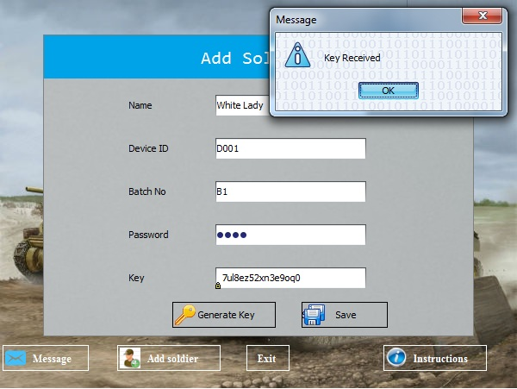

Slide 20
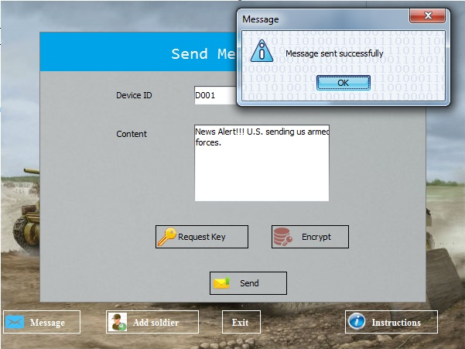

Slide 21
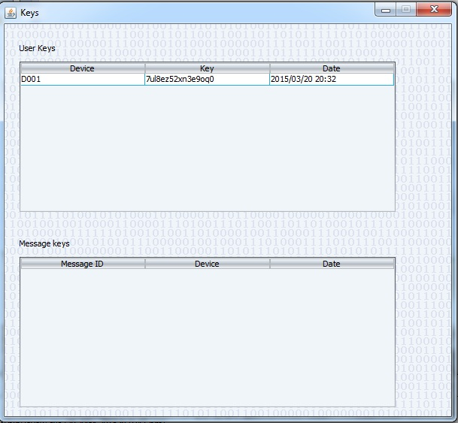
Key Authority

Slide 22
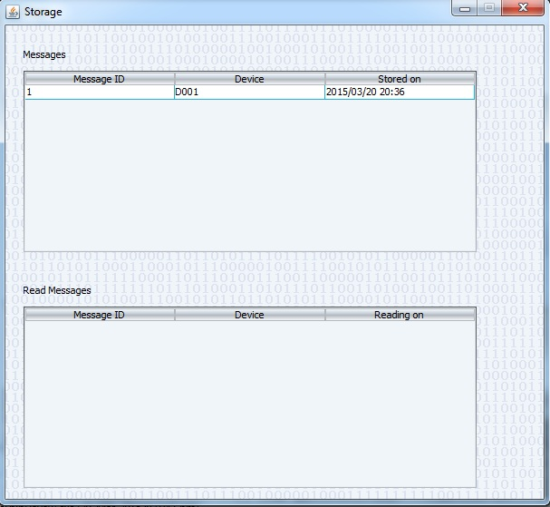
Storage Node

Slide 23
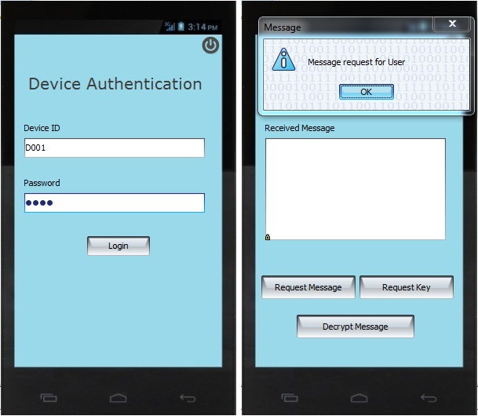

Slide 24
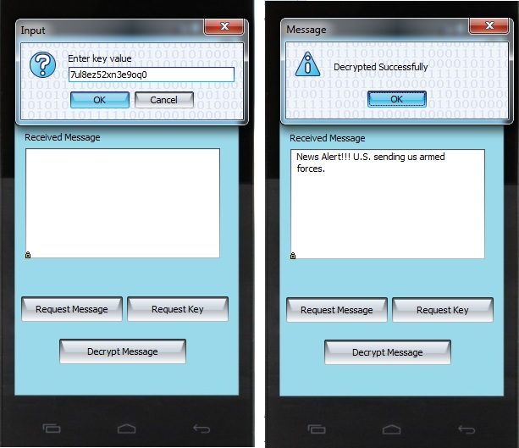

Slide 25
References
[1]. Nanxi Chen, Dijiang Huang and Mario Gerla , “Secure, selective group broadcast in vehicular networks using dynamic attribute based encryption” in Ad Hoc Networking Workshop (Med-Hoc-Net), 2010 The 9th IFIP Annual Mediterranean, 2010, pp. 1 – 8.
[2]. Osada, S. , Kajita, K. , Fukushima, Y. , Yokohira, T. , “TCP incast avoidance based on connection serialization in data centre networks” in Communications (APCC), 2013 19th Asia-Pacific Conference , 2013 , pp. 142 – 147.
[3]. Jinguang Han, Willy Susilo, Yi Mu, and Jun Yan , “Privacy-Preserving Decentralized Key-PolicyAttribute-Based Encryption”, Parallel and Distributed Systems, IEEE Transactions on (Volume:23 , Issue: 11 ) , 2012 , pp. 2150 – 2162.
[4]. Zhibin Zhou, Dijiang Huang, and Zhijie Wang, “Efficient Privacy-Preserving Ciphertext-Policy Attribute-Based-Encryption and Broadcast Encryption” , Computers, IEEE Transactions on (Volume:64 , Issue: 1 ) , 2013 , pp. 126 – 138.
[5]. Fuchun Guo, Yi Mu, Willy Susilo, Duncan S. Wong, and Vijay Varadharajan, “CP-ABE With Constant-Size Keys for Lightweight Devices”, Information Forensics and Security, IEEE Transactions on (Volume:9 , Issue: 5 ), 2014 , pp. 763 – 771.
[6]. Ming Li, Shucheng Yu, Yao Zheng, Kui Ren, and Wenjing Lou, “Scalable and Secure Sharing of Personal Health Records in Cloud Computing Using Attribute-Based Encryption”, Parallel and Distributed Systems, IEEE Transactions on (Volume:24 , Issue: 1 ), 2012, pp. 131 – 143.
[7]. Junbeom Hur , “Improving Security and Efficiency in Attribute-Based Data Sharing”, Knowledge and Data Engineering, IEEE Transactions on (Volume:25 , Issue: 10 ), 2013 , pp. 2271 – 2282.

Slide 26
References
[8]. Jin Junzuo Lai, Robert H. Deng, Chaowen Guan, and Jian Weng , “Attribute-Based Encryption With Verifiable Outsourced Decryption”, Information Forensics and Security, IEEE Transactions on (Volume:8 , Issue: 8 ), 2013 , pp. 1343 – 1354.
[9]. J.Bethencourt, A.Sahai and B.Waters, “Ciphertext-Policy Attribute-Based Encryption”, in Proc. IEEE symp. Security Privacy , 2007, pp. 321-334.
[10]. Jin Li, Jingwei Li, Xiaofeng Chen, Chunfu Jia, and Wenjing Lou, “Identity-Based Encryption with Outsourced Revocation in Cloud Computing”, Computers, IEEE Transactions on (Volume:64, Issue: 2 ), 2013 , pp. 425 – 437.
[11]. Soumya Parvatikar, Puja Prakash, Richa Prakash, Pragati Dhawale, S.B. Jadhav , “Secure sharing of personal health records using multi authority attribute based encryption in cloud computing” , International Journal of Technical Research and Applications, Volume 1, Issue 5 (Nov-Dec 2013), PP. 50-52.
[12] M. Chase, “Multi-authority attribute based encryption,” in Proc. TCC, 2007, LNCS 4329, pp. 515–534.
[13] D. Huang and M. Verma, “ASPE: Attribute-based secure policy enforcement in vehicular ad hoc networks,” Ad Hoc Netw., vol. 7, no. 8, pp. 1526–1535, 2009.
[14] S. Roy andM. Chuah, “Secure data retrieval based on ciphertext policy attribute-based encryption (CP-ABE) system for the DTNs,” Lehigh CSE Tech. Rep., 2009.

Slide 27

Publication Details
Presented paper on “Attribute-Based-Encryption in Disruption Tolerant Military Networks to secure data access” at National Conference on Emerging Trends in Computing(ETIC-2015) held at “S.A. Engineering College” , Avadi. PP. 58 – 63.

Slide 28
Thank You

